Slide 1

UTILIZATION OF FUND UNDER RUSA - 2.0
DHING COLLEGE
DHING :: NAGAON :: ASSAM

Slide 2
Summary of the Grant
College Id :– 17356
Component Name :– Infrastructure Grant to College
Sub Components :–
a) Repairing, Renovation & New Construction
b) Equipment (Sports & Laboratory)
Total Amount Sanctioned :– Rs. 2 Crore
Amount Released in 1st Instalment on 17/06/2019 :– Rs. 1 Crore
a) Rs. 70 Lakh for Civil Work
b) Rs. 30 Lakh for Equipment
Amount Released in 2nd Instalment on 08/04/2022 :– Rs. 50 Lakh
Amount Released in 3rd Instalment on 18/12/2023 :– Rs. 50 Lakh
Percentage of Utilization :– 100%
Supervising Authority :– Housefed, Assam

Slide 3
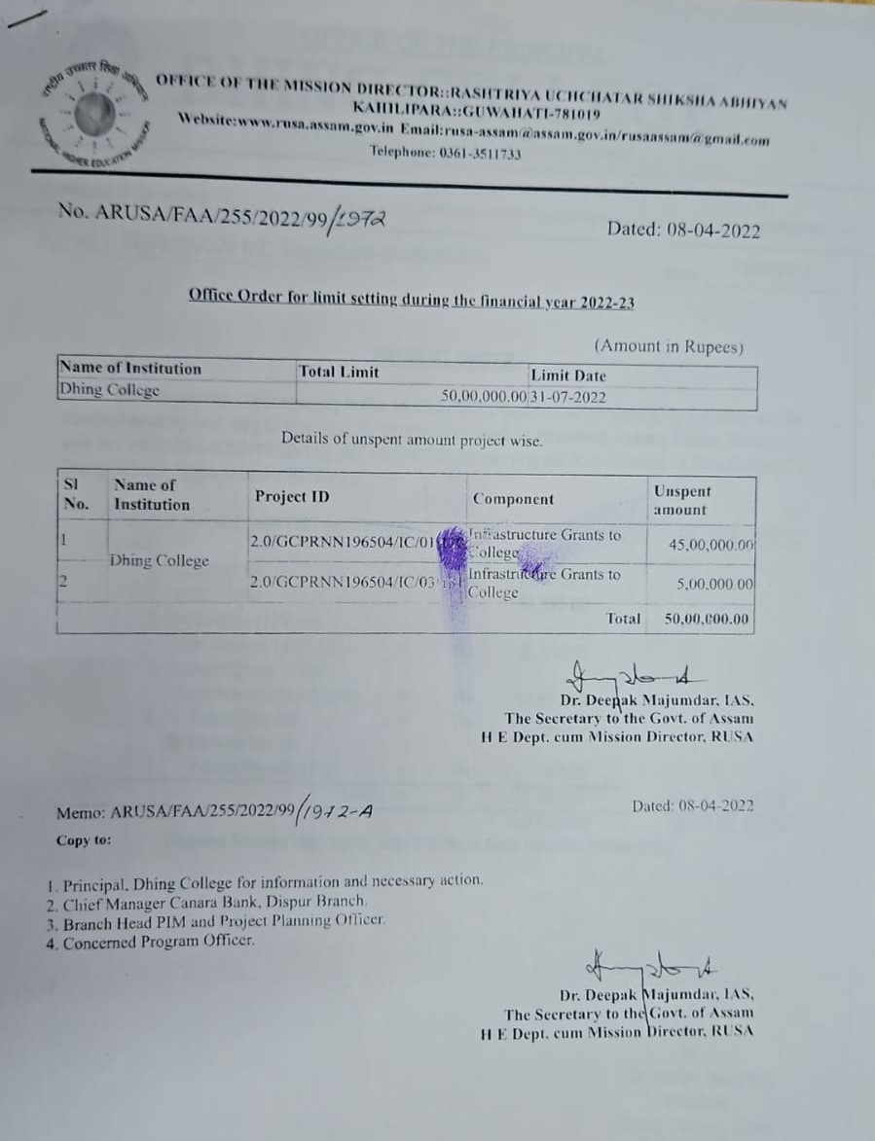
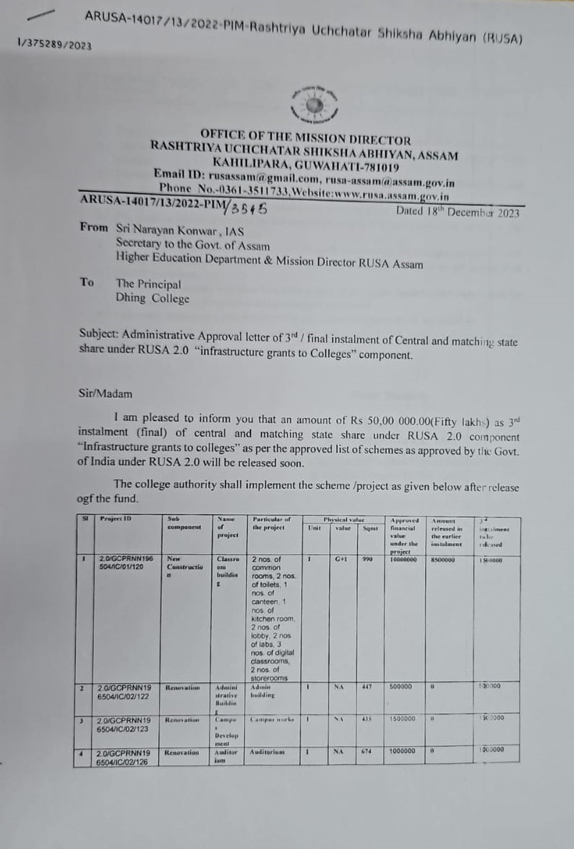

Slide 4
PROJECT WISE DISTRIBUTION OF FUND
Project Id. | Amount Sanctioned | Percentage of Utilization | Remarks
2.0/C-17356/01/120 (New Construction) | 1 Crore | 100% | Work Completed
2.0/C-17356/01/121 (Renovation of Administrative Building) | 5 Lakh | 100% | Work Completed
2.0/C-17356/01/122 (Renovation of Academic Building) | 5 Lakh | 100% | Work Completed
2.0/C-17356/01/123 (Boundary Wall) | 15 Lakh | 100% | Work Completed
2.0/C-17356/01/124 (Renovation of Hostel) | 5 Lakh | 100% | Work Completed
2.0/C-17356/01/125 (Renovation of Class Room) | 15 Lakh | 100% | Work Completed
2.0/C-17356/01/126 (Renovation of Auditorium) | 10 Lakh | 100% | Work Completed
2.0/C-17356/01/127 (Renovation of Laboratory) | 5 Lakh | 100% | Work Completed
2.0/C-17356/03/128 (Sports Goods) | 5 Lakh | 100% | Work Completed
2.0/C-17356/03/129 (Computer & Accessories) | 15 Lakh | 100% | Work Completed
2.0/C-17356/03/130 (Laboratory Equipment) | 10 Lakh | 100% | Work Completed
2.0/C-17356/03/131 (Books & Journals) | 10 Lakh | 100% | Work Completed

Slide 5
